Slide 1

RunVenture Fitness Tracker
(Based on MapMyRun.com)
Created By: Jill Platts

Slide 2
Introduction
Baseline App: MapMyRun.com
A fitness tracking app designed for runners
and fitness enthusiasts.
Core Features:
GPS-based route mapping
Workout and goal tracking
Basic community and social interaction
Project Goal: To enhance the user experience, functionality, and accessibility of the app through a modern, user-centered redesign.
(Re)design Focus:
Improve overall usability through clearer navigation and a more intuitive user experience
Increase user engagement with personalized features and community-driven interactions
Enhance visual design using a clean, modern, and responsive interface
Expand core functionality to better support runners before, during, and after their workouts

Slide 3
Introduction
Initial Critique of MapMyRun.com:
Strengths
Quick and user-friendly account setup process
Clear tabbed navigation for core features (Workouts, Routes, Community)
Reliable workout tracking functionality
Consistent branding and legible typography
Stable performance and fast page loads under normal conditions
Weaknesses
No personalization for user fitness goals
Low engagement from basic social features
No in-app music or podcast playback
Limited post-run insights and feedback
Limited route previews
Key Enhancements Proposed:
Personalized Training Plans Tailored plans based on user goals and fitness levels.
Social Challenges Custom and community challenges to boost motivation and user engagement.
Music & Podcast Integration In-app playback controls to avoid switching apps mid-run.
Post-Run Insights Smart recovery suggestions, such as hydration tips, based on workout intensity.
Route Conditions Route previews with surface type, elevation, and traffic levels.

Slide 4
Design Process & Concept Testing
Wireframing
Created interactive wireframes in Figma,
showcasing proposed features:
Personalized Training Plans
Social Challenges
Music & Podcast Integration
Post-Run Insights
Route Conditions
Focused on usability, accessibility, and visual
hierarchy early in the design.
Pre-Usability/Concept Testing Methodology
Conducted pre-prototype testing with 5 participants of varying fitness levels.
Sessions were remote and structured, lasting ~5 minutes each.
Participants were guided through the wireframes and asked open-ended questions about:
Feature clarity
Ease of use
Visual appeal
Suggestions for improvement

Slide 5
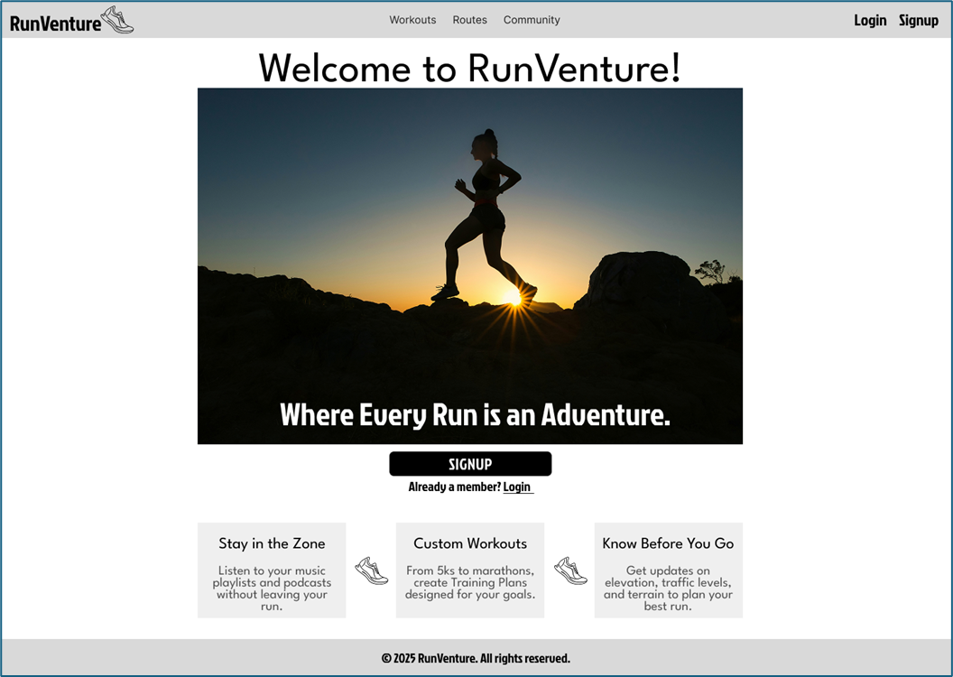
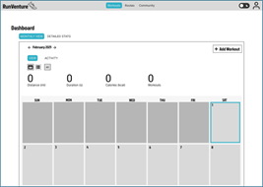
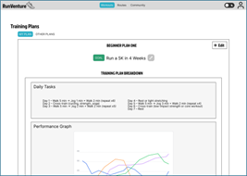
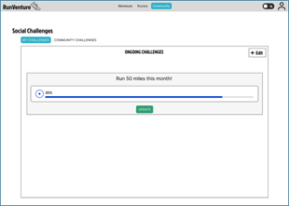
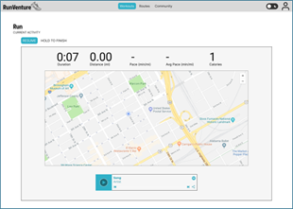
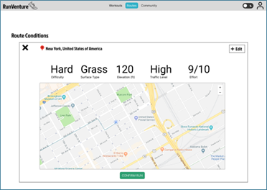
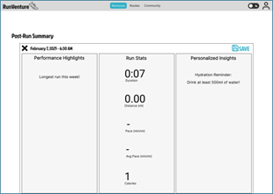
Wireframes

Slide 6
User Feedback
Positive Feedback Highlights
Training Plans: Well-received; users appreciated structure without a subscription.
Route Conditions: Seen as helpful for safety and route planning, especially in unfamiliar areas.
Social Challenges: Motivating and fun, offering potential for stronger community engagement.
Identified Pain Points
Post-Run Insights: Informative, but text-heavy; needed more visuals.
Music Integration: Confusion about Spotify Premium requirements.
Onboarding: Suggested short tutorial or tooltips to guide new users.
Design Adjustments Made
Simplified layout for post-run insights (icons, sections).
Added quick start button with tooltip to dashboard.
Enabled custom social challenge creation and improved visual layout.
Added option to share social challenges and view participant lists.

Slide 7
Prototyping Process & Interactive Features
Created a fully interactive prototype in Figma:
Evolved from initial wireframes and concept testing
Styled and linked for realistic user flow simulation
Used as the foundation for usability testing sessions
User Flows Designed For:
Goal editing and training customization
Social challenge viewing, sharing, and participation
In-app Spotify playback during live runs
Viewing post-run summaries with hydration tips and recovery suggestions
Route previews based on start/end selection with elevation and surface feedback

Slide 8
Prototyping – Usability Testing & Outcomes
Testing Setup:
Conducted structured usability testing with 8 participants
Used a guided task handout and verbal feedback format
Sessions focused on intuitiveness, visual clarity, and ease of feature use
Each session lasted ~5 minutes
User Feedback:
Users wanted clearer edit icons and more customization in training plans
Challenges needed friend invites, leaderboards, and visual engagement
Music playback was smooth, but needed more control options
Post-run suggestions felt helpful, but needed more visuals and personalization
Route Conditions was well-liked (users requested weather and safety data)
Core Testing Areas:
Editing and customizing training plans
Navigating and interacting with challenges
Controlling music during a live run
Understanding post-run stats and suggestions
Selecting routes and interpreting route conditions
Outcome:
Feedback led to further design iterations
The prototype was refined to better support clarity, motivation, and usability

Slide 9
Development Process - Overview
Built with React.js:
Modular components for pages and features, such as Run tracking, Route planning, and Training plans
Managed state with useState/useEffect, storing all user data locally in localStorage (no backend required)
Responsive UI design built with modern CSS for mobile and desktop compatibility
Core Pages Developed:
Dashboard – Central hub for workouts, stats, and navigation
Run – Live map tracking with real-time stats and music
Post-Run – Auto-insights with hydration tips and run achievements
Route Conditions – Interactive route preview with difficulty scoring
Social Challenges – Track, update, share, and view progress with others
APIs:
Geolocation API – Tracks the user’s live GPS location during runs
Google Maps JavaScript API – Renders interactive maps and markers
Google Maps Directions API – Snaps selected routes to walkable roads
Google Maps Elevation API – Retrieves elevation data for route difficulty scoring
Spotify Embed API – Plays music and playlists directly in-app with mobile support
Spotify Web API – Loads public playlists by URL and supports logged-in user playlists

Slide 10
Development Process - Challenges & Solutions
Challenge 1: Location Tracking Permissions
Problem: Users blocking location access broke route tracking
Solution: Fallback coordinates (UNC Charlotte) added, with permission prompt and re-request option if location is denied.
Challenge 2: Dynamic Route Snapping
Problem: Manually selected paths needed to align with real roads
Solution: Integrated Google Directions API to snap paths for real-time visuals
Challenge 3: Visual Complexity on Post-Run Page
Problem: Post-run page was too text-heavy and cluttered
Solution: Segmented insights into visual tiles, added icons, and reduced reading load
Challenge 4: Managing State Across Pages
Problem: Persisting user data (like runs or challenges) without a backend
Solution: Tied all data to user email in localStorage, maintaining separation per user
Outcome: A responsive React app that runs smoothly across devices and stores all data locally, featuring interactive maps, music playback, social tracking, custom training goals, and post-run insights.

Slide 11

Live Demo

Slide 12
Conclusion
Key Learnings:
Built a fully functional React.js fitness app with real-time GPS and music integration
Gained experience designing modular components and managing local app state
Practiced iterative, user-centered design through concept and usability testing
Developed proficiency in Figma prototyping and cross-platform browser testing
Future Considerations:
Add secure backend for account authentication and cloud data storage
Implement leaderboard, badges, and streak tracking to boost engagement
Integrate real-time data (weather, air quality) into route conditions
Final Reflection: RunVenture delivers a modern fitness tracking experience through live GPS, Spotify integration, personalized training plans, social challenges, post-run insights, and route condition previews, all integrated into a fully responsive app.

Slide 13

Q&A

Slide 14

Thank You!

